Slide 1
Conflict Resolution for CBLE
Instructor

Slide 2
Terminal Objective
Upon completion of this module, the participant will be able to identify the phases of “acting-out” in conflict, and have an understanding of what active listening entails.

Slide 3
Enabling Objectives
Describe different sources of conflict
Identify the seven phases of “acting-out”
Describe different signs of agitation to look for
Identify during which phases of “acting-out” an intervention will work
Discuss different strategies for de-escalation
Identify the six active listening techniques

Slide 4
Sources of Conflict
Conflict comes from differences
Examples of differences
Beliefs
Expectations
Goals
Values
Behaviors
Notes:
Conflict arises from everyday differences. Differences can come in many forms, such as: religion, personal beliefs, expectations at school, unattainable goals, behaviors and values. A simple example applicable to schools is the difference in student behaviors. Two students that behavior in different manners could easily become agitated and experience a certain level of conflict. This could result in verbal or physical altercations.

Slide 5
Acting-Out Behavior
Sources of conflict cause “acting-out”
Seven phases of acting-out
Calm
Trigger
Agitation
Acceleration
Peak
De-escalation
Recovery
Notes:
When an individual “acts-out” it is generally from an underlying conflict. There are seven phases of the acting out behavior that will be discussed in this module. These include a calm, trigger, agitation, acceleration, peak, de-escalation, and recovery phase. If the process can be interrupted during or before the agitation phase the individual will not peak and de-escalation will not be needed.

Slide 6
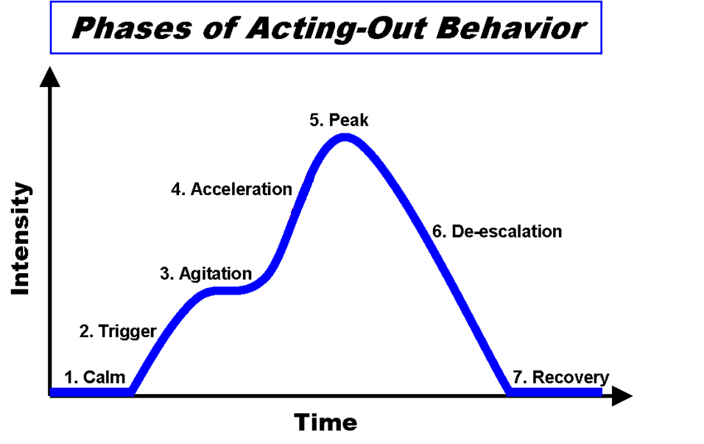
Notes:
Here is a visual representation of the conflict continuum. The module will now delve deeper into the phases, but it is easy to see how one leads to another. It is also possible to see how quickly each phase moves. The individual can be calm for a long period of time and then the trigger comes and moves quickly into agitation for the individual. Agitation plateaus and can take a while, but once the individual begins to accelerate (s)he moves quickly into a peak. De-escalation is constant and without plateaus, but it is not fast.

Slide 7
Calm Phase
First phase of behavior
Responsive to directions
Accepting of corrective feedback
Ignores distractions and/or inappropriate behaviors of others
Teachers can manage instruction
Notes:
Most students and individuals will be in the calm phase. At this point the individual is not experiencing any direct conflict. The individual is responsive and accepts feedback. At this point differences in others’ behavior are not a distraction and don’t bother the individual.

Slide 8
Trigger Phase
Second phase of acting out
Triggers are referred to as:
Setting events
Aversive stimuli
Antecedents
Behavior is a series of unresolved issues
Repeated failures, confrontations with students, argument with parent, substance abuse, family member illness, etc.
Notes:
The second phase can happen at any time for the individual. Something has bothered the individual enough to take the individual out of the calm phase. Triggers have been introduced in previous modules, but they go by different terms. For instance, functional behavior assessment refers to triggers as antecedents, or the causes of the problem behavior prior to a functional behavior assessment.
The trigger is essentially a behavior that results from unresolved issues in the individual’s life. There are an infinite number of issues that can be a trigger. For students this could be repeatedly failing assignments, having a fight with his parents before school, drug problems, or even a sick family member. Any of these can trigger the individual to become agitated and direct that agitation at someone else.

Slide 9
Trigger Phase
Methods for stopping behavior at trigger phase:
Identify the trigger and predict problem
Specify expected behaviors
Modify context of situation
Provide reinforcement for expected behavior
Promote expected behaviors
Notes:
There are several methods for stopping a potential conflict at the trigger phase. If you are able to identify the trigger and predict the problem (e.g., if a student is having family issues it may be beneficial to speak with the student to see what’s going on). By specifying what the expected behaviors are, promoting them, and positively reinforcing the individual for staying within the expected behavior the trigger can be curtailed. Modification of the context will generally be done by the teachers in a school. If the student can’t concentrate because of a physical aspect of the classroom and this lack of concentration leads to a trigger, the teacher can modify the physical aspect of the classroom to remove the possibility of a trigger.

Slide 10
Agitation Phase
Caused by inability to control trigger
Long lasting phase
Change in behavior
Lack of attention/concentration
Increased stress
Real possibility that “acting-out” will actually occur
Imperative that intervention occurs during, or before, this phase.
Notes:
If the trigger is not able to be controlled the individual will enter the agitation phase. As mentioned earlier, this phase has the potential to last a long time. An individual may become agitated and stay agitated for a long time before progressing to the next phase. Agitation is generally accompanied by a change in the individual’s behavior. They may lose attention and become ever more stressed. When an individual become agitated there is a real possibility that the situation could escalate and intervention is imperative. Next, we’ll discuss the signs of agitation.

Slide 11
Signs of Agitation
Body language
Limited eye contact
Busy hands – tapping hands, wringing hands, etc.
Off task or head down
Starring into space
Moving in and out of groups with no purpose
Verbal cue
Unwillingness to talk or use of disrespectful tone
Close ended, short responses
Notes:
There are many signs of agitation, both body language and verbal cues are hints that an individual is agitated. Body language is as important as verbal communication in everyday life…this is very much the case with identifying agitation.
Some of the body language cues include: making very limited eye contact with whomever the individual is speaking with; having busy hand, meaning tapping a pencil/hands/or feet uncontrollably, wringing hands, rubbing thighs, etc.; being off task or keeping one’s head down for a long period of time; or even just starring into space and not paying attention to anything else.
Some of the verbal cues are an unwillingness to talk or using a disrespectful, sharp tone when speaking. If the student uses close ended, short responses (i.e., no, yes, ‘cause) the student is also exhibiting verbal cues of agitation.

Slide 12
Acceleration and Peak Phases
Behavior is focused and directed toward the staff.
Arguing
Noncompliant
Provoking
Limit Testing
Threats
Destruction of property
Notes:
Once the individual has been agitated and intervention was not accomplished he can move into an acceleration phase. The acceleration phase and peak phase are interrelated. Once acceleration has started the peak is generally accomplished once intervention happens.
During the acceleration phase the behavior of the individual is focused and directed directly toward other staff. The individual will become vocal and begin arguing, become very noncompliant, provoke others, test limits of the ones in charge, make threats or even destroy property in the process. Once this phase has stopped the “acting-out” behavior has also peaked. By looking at the included list you can make out a continuum of events. It starts will arguing and moves toward destruction. If CBLE or administration is able to intervene at limit testing, threats, destruction, or any other more serious action will not take place. The event in this instance peaks at limit testing.

Slide 13
Example of 1st Five Steps
Video: http://www.youtube.com/watch?v=_ZpDnXYIFjo
Notes:
This clip from “The Water Boy” shows how an individual moves through the first five steps of “acting-out” it’s clear that he is calm and is triggered during the lecture. He then becomes agitated when he is told that he and his mother are incorrect. The teacher then accelerated the situation at the end and it peaks with a physical altercation.

Slide 14
De-escalation and Recovery Phases
Final two phases deal with defusing the behavior.
Concentrate on:
Effective communication
Active listening skills
Remaining non-confrontational
Notes:
The last two phases, de-escalation and recovery, deal with defusing the situation after it peaks and debriefing after de-escalation.
It is imperative that effective communication techniques are deployed, as well as active listening skills. Also, stay non-confrontational. If you confront the individual soon after the incident it is possible to trigger another incident and it may accelerate to a higher level before peaking.

Slide 15
Strategies for Defusing Situation
Avoid escalating prompts
Shouting, touching student, put-down statements, becoming defensive, communicating anger through body language
Remain calm, detached, and respectful
Pause – the most powerful response is no immediate response
Be non-confrontational
Utilize active listening skills
Notes:
Once again, try not to confront the individual. In defusing a situation you need to avoid escalating prompts. There are several escalating prompts, some of which are: shouting, touching the student, putting-down the individual, becoming defensive, or letting you body language translate anger to the individual. Remember, body language tell the receiver of information as much, or more, than verbal communication.
Remain calm and detached from the situation. You don’t want to trigger another incident by not being calm. By being detached you are able to retain objectivity. Also, remaining respectful can ensure that you don’t use escalating prompts.
Pause. By pausing between statements you allow the statement to sink in to yourself and the individual. This will help with retention or give whomever an opportunity to think before speaking.
The next section will deal with utilizing active listening skills.

Slide 16
Active Listening
An integral component of conflict resolution
Learned skill that basically
Lets person know they are being heard
Allows person to vent
Eliminates poor listening habits
Promotes retention of what is communicated
Notes:
Active listening is integral in the de-escalation phase of conflict resolution. By exercising active listening skills you let the individual know that they are being heard and not ignored, you allow the person to vent their frustrations and in essence explain what happened. You also eliminate various poor listening habits, which will be discussed momentarily, and promote the retention of what is being communicated back from the individual.

Slide 17
Poor Listening Habits
Faking attention
Allowing trigger words to interfere with the crux of the message
Being too eager to speak…just listen
Daydreaming
Interrupting
Notes:
Some of the seriously poor listening habits that many use are included in this slide. Don’t fake attention. If you attempt to act like you are paying attention, yet your eyes continually wonder the individual will know that you are not listening and don’t care. Don’t get lost in the trees…look at the forest. The individual is going to still be upset and will have many trigger words mixed in with the overall message. Pay attention to the whole story to get an idea about what triggered the initial incident.
Just listen…don’t feel like you have to speak. Also, avoid daydreaming. This relates back to the first poor listening habit…faking attention. Do not interrupt the individual, let them speak and get the whole story.

Slide 18
Good Listening Habits
Concentrate/Focus
Look for non-verbal cues
Show understanding
Allow person to talk uninterrupted
Repeat main points
Acknowledge feelings of individual
Notes:
There are several good listening habits that should be deployed. Make sure that you concentrate on what you’re doing…focus at all times. Paying attention to non-verbal cues can paint a better picture than ignoring them. Noticing that the individual goes from having unclenched hands to clenched hands while speaking about someone can trigger you to explore that relationship. This other person obviously bothers the individual. Another good habit is to show that you understand what is being said. This can be accomplished by allowing the individual to speak uninterrupted, repeat main points to show you heard them, and acknowledge the individual’s feels.

Slide 19
Signs of Progress
Positive Signs
Situation is becoming less volatile
Individual is speaking slower/more calmly
Threats decrease
Negative Signs
Individual becomes more angry/emotional
Individual stops speaking with you
Notes:
Throughout the de-escalation phase there will be several signs of progress presented to you through active listening. Positive signs of progress are that the situation is becoming less volatile and the individual appears to be calming down. Also, when the individual starts to speak slower, takes time to think, doesn’t argue, and speaks more calmly, the situation is improving. When the threats decrease or stop the situation has also improved.
There are a couple of negative signs to look out for as well. When the individual become more angry or much more emotional you need to change strategies…the individual is being triggered and becoming agitated. Also, if the individual stops speaking to you he doesn’t trust that you are paying attention, or has become agitated again.

Slide 20
Active Listening Techniques
CBLE should use:
Minimal encouragement
Paraphrasing
Emotional Labeling
Mirroring meaning – repetition of main idea
Open-ended questions
Effective pauses
Notes:
Some techniques of active listening that are going to be further explored are presented here. These six techniques, that can prove to be effective, are being minimal encouragement, paraphrasing, emotional labeling, mirroring, open-ended questions, and effective pauses. Each of these will be discusses further in upcoming slides.

Slide 21
Minimal Encouragers
Brief, well-timed responses informing individual you are paying attention
Keeps individual talking/leads to more info
Example:
“I’m so mad, I just want to hit Vicky”
Response:
“And/why”
Good minimal encourager. It opens the door for more explanation w/o challenging the subject
Notes:
Minimal encouragers are brief, well-timed responses that inform an individual that you are paying attention to him or her. These are effective for keeping the individual talking and leads to much more information. This step also keeps the individual from thinking that you are talking too much or being condescending.
An example could be, “I’m do mad, I just want to hit Vicky!” A minimal encourager could be simply “And or why”. This opens the door for the individual to explain the situation further and doesn’t challenge the individual. This is a good way to keep from agitating the individual.

Slide 22
Paraphrasing
Repeating the individual’s message in CBLE’s own words
Beneficial because it:
Shows that the CBLE heard the message
Softens the individual’s statement
Invites the individual to say more
Shows interest
Notes:
Paraphrasing consists of repeating an individual’s communication in your own words. This shows the individual that you heard the message and understand it well enough to make sense of it in your own words. It can soften the individual’s statement. If the individual uses harsh terms, like “destroy”, the paraphrased sentence could change that to “hurt”. This small change can help in de-escalating the situation.
Also, the individual will be invited to expand. Once you paraphrase the statement the individual can hear what it sounds like and realize more explanation is needed to clarify part of the statement. Lastly, paraphrasing shows that you are interested and can keep the individual from becoming agitated again.

Slide 23
Emotion Labeling
Use of emotionally descriptive words to show the CBLE understands the feelings the individual is experiencing
“You sound pretty upset and hurt about___”
Recognizes feelings without judgment
Identifies that the hurt underlies the anger in the situation
Notes:
Emotion labeling consists of using emotionally descriptive words to show that you understand the feelings the individual is experiencing. An example statement would be “You sound pretty upset and hurt about _____”. A statement like this recognizes the feelings of the individual without passing judgment. It shows you are paying attention and helps keep the individual from becoming agitated again. This can also help identify the hurt, or trigger, that could have been the cause of the anger and situation.

Slide 24
Mirroring
Repeating back the last word or phrase
Shows the CBLE is paying attention and understands what is being said
Student: “I’m just so mad, it’s because of all the other times, not because I’m crazy”
CBLE: “All the other times”
The student knows the CBLE is paying attention and this has segued into the student explaining what “all the other times” are.
Notes:
Mirroring is when you repeat back the last word or phrase to the individual. This is a way of showing that you are paying attention and understand what is being said. For example, a student says “I’m just so mad, it’s because of all the other times, not because I’m crazy”. The CBLE could mirror with “All the other times”. The student knows that the CBLE is paying attention and this has segued into the student explaining what “all the other time” are.

Slide 25
Open-Ended Questions
Questions that encourage the individual to talk
Helps clarify what is going on
Shows that the CBLE is paying attention
Good Examples:
“Tell me what happened”
“Explain the situation”
Bad Example:
“Did you push him?”
Notes:
Open-ended questions will encourage the individual to talk and explain himself. Open-ended questions help clarify what is going on, and also shows that the CBLE is playing attention and wants to know more. Good examples of open-ended questions would be “tell me what happened” or “explain the situation”. A bad example of an open-ended question would be “did you push him”…this can easily be answered yes or no. After a closed question you’ll have to continue asking more questions and could easily agitate the individual again.

Slide 26
Effective Pauses
Periods of silence used to emphasize a point or encourage the individual to say more
When to use:
After an open-ended question
After an individual seems to have finished
gives him an opportunity to add anything
After the CBLE makes an important point
Notes:
Effective pauses are periods of silence that can be used to emphasize a point or even encourage the individual to say more. It is useful to use an effective pause after an open-ended question. This will allow the individual plenty of time to think about the question thoroughly before answering. Pauses could also be used after an individual seems to be finished talking. This give him an opportunity to add anything that he forgot to mention in the original answer. Pauses are also effective after you make an important point. This give the individual an opportunity to absorb what was said before you move on.

Slide 27
Recovery
Final phase of conflict cycle
After de-escalation it is important to find out what caused the activity.
You may not know what the trigger was
Why did this happen?
What can be done in the future to prevent the conflict from occurring?
Notes:
The final phase is recovery. This phase is important after de-escalation to find out exactly what caused the activity. Now that you have listened to the individual, calmed the individual down, and may have a vague understanding of what caused the behavior it is time to debrief. It could be possible that you know the trigger at this point from actively listening to the individual, but if you need clarification this is the time. The individual should be calm again and you can gracefully ask what caused the incident. Why did it happen? You may even ask what can be done in the future to prevent this from occurring again. The individual may have valid suggestions for avoiding the situation.

Slide 28
Sources
Bordelon, P. & Durocher, (n.d.). Managing difficult behaviors: An overview of the conflict cycle and verbal de-escalation strategies. PowerPoint presentation,
Flannery, B. (n.d.). Conflict resolution strategies - -skills for managing conflict. Retrieved from http://blakeflannery.hubpages.com/hub/Conflict-Management-Insight-and-Skills
www.iris.peabody.vanderbilt.edu/bi1/bi1_02.html
Mullins, W. Texas State University, (n.d.). Active listening: The heart of negotiations. PowerPoint presentation for hostage negotiation training
Mullins, W. Texas State University, (n.d.). Communication skills I: Safety, security, trust. PowerPoint presentation for hostage negotiation training
http://www.123rf.com/photo_3569354_young-asian-business-man-sitting-daydreaming.html

